Slide 1


ANALYSIS OF STUDENTS
PERFORMANCE USING
PYTHON
Presented By: Saba Zaman
Supervisor: Ma’am Hina Javed
BSCS 7th A | Department of Computer Science
Federal Urdu University of Arts, Science & Technology, Islamabad

Slide 2

ABSTRACT
PERFORMANCE INSIGHTS
PYTHON-POWERED ANALYSIS
STRATEGIC IMPROVEMENT
This project rigorously analyses student scores across core subjects: Mathematics, English Language, and Science.
We leverage powerful Python tools, including Pandas and Matplotlib, to meticulously explore hidden patterns and compare performance trends between subjects.
The primary objective is to pinpoint student strengths and identify specific areas of weakness, providing actionable insights to enhance the learning process and educational outcomes.

Slide 3

INTRODUCTION: ELEVATING EDUCATIONAL QUALITY THROUGH DATA
Understanding student performance is fundamental to improving the quality of education. By systematically analysing academic results, we can pinpoint areas where students excel and, more importantly, identify subjects or topics that require additional support and intervention.
This report specifically focuses on student achievement in three foundational subjects: Mathematics, English Language, and Science. Each subject presents unique challenges and opportunities for learning, and a detailed examination of performance can inform targeted teaching strategies.
The use of Python programming proves invaluable in this endeavour, offering robust capabilities for data manipulation, statistical analysis, and compelling visualisations. This approach makes complex data analysis more accessible and impactful.

Slide 4



METHODOLOGY: A PYTHON-DRIVEN APPROACH
DATA ACQUISITION
Student scores in Mathematics, English Language, and Science were meticulously collected, forming the raw dataset for our analysis.
TOOLING: PYTHON'S POWER
We utilised key Python libraries:
Pandas: Essential for efficient data handling, cleaning, and structuring.
Matplotlib: Employed for generating insightful graphs and charts to visualise performance trends.
ANALYTICAL PROCESS
Our analytical journey followed a structured three-step process:
Loading and thorough cleaning of the raw data to ensure accuracy.
Calculation of key descriptive statistics for each subject.
Creation of compelling visualisations to illustrate findings.

Slide 5
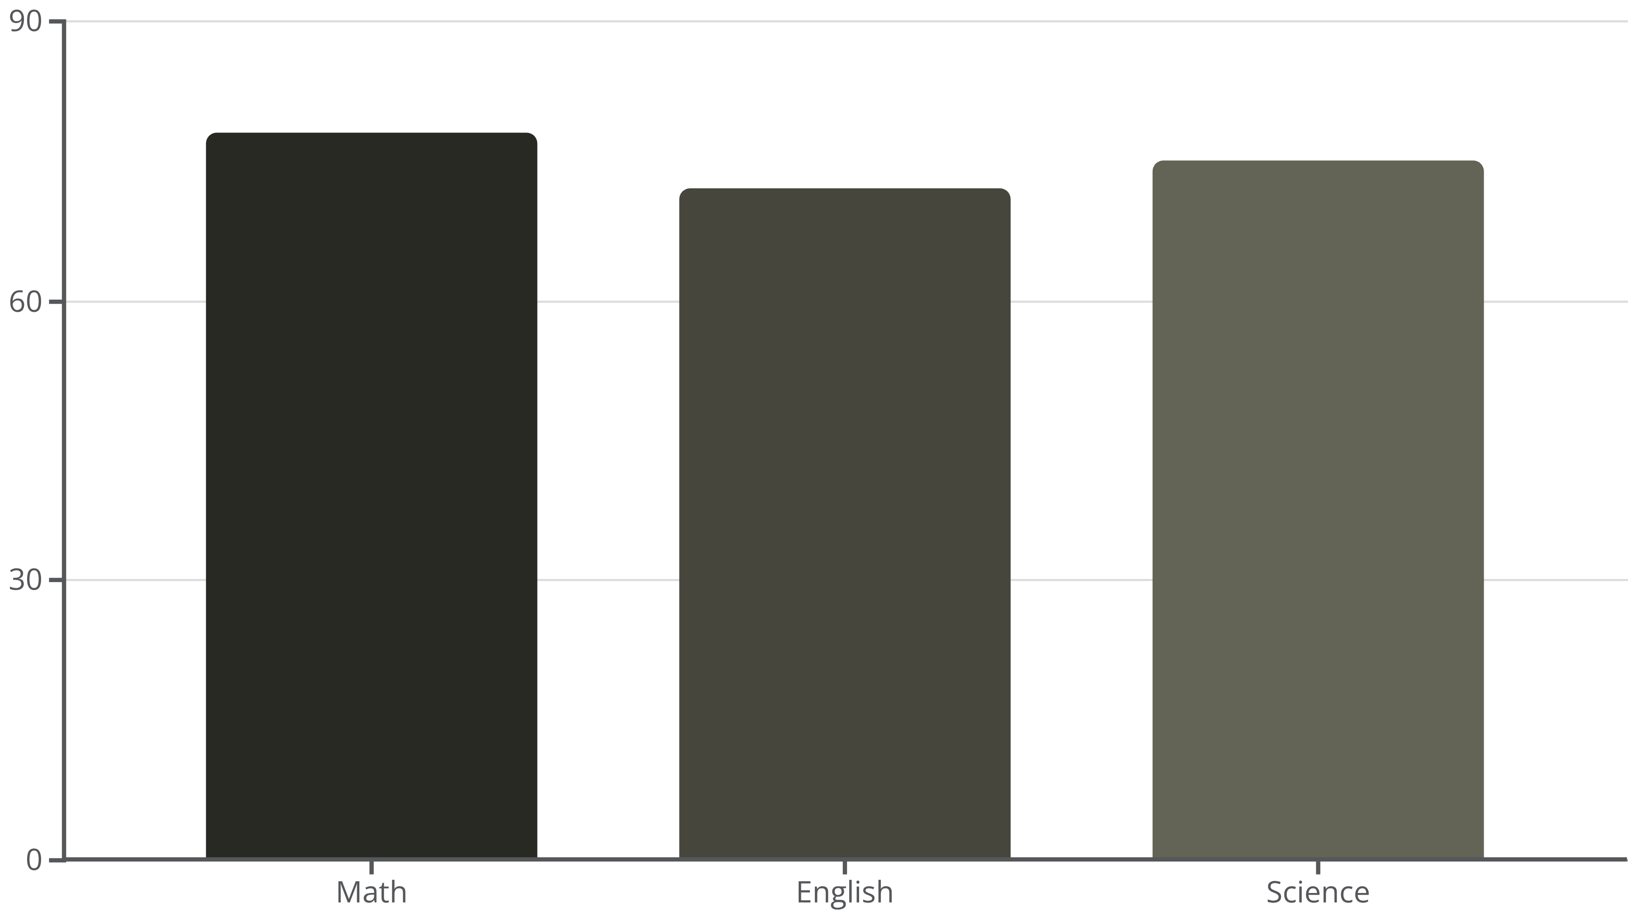
COMPARISON OF SUBJECT PERFORMANCE: A VISUAL SYNTHESIS
A side-by-side comparison of average scores clearly illustrates performance disparities. Visual charts, such as the one above, provided a clear distribution of scores,
highlighting subject-specific strengths and weaknesses.
It was identified that students generally performed best in Mathematics, followed closely by Science, with English showing slightly lower average performance. Possible reasons for these differences might include teaching methodologies, student engagement with the subject matter, or external factors influencing learning.

Slide 6
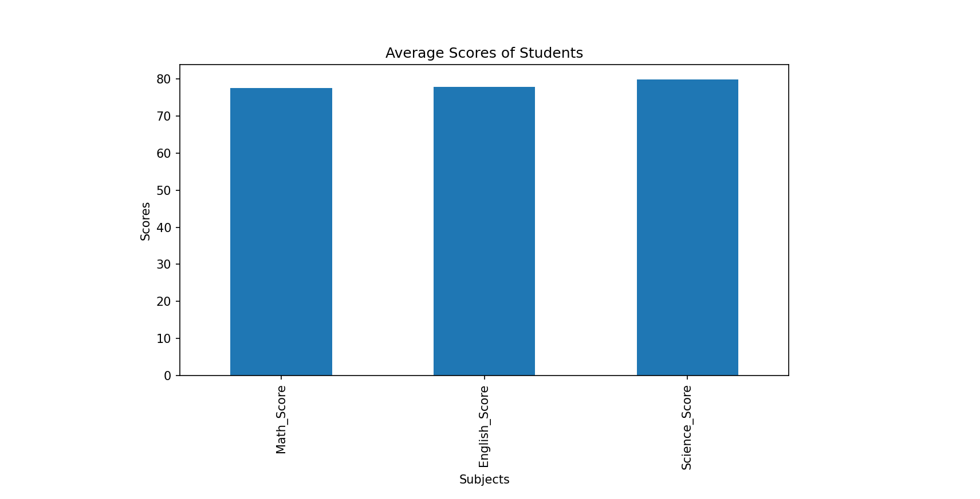
RESULTS
Mathematics recorded the highest average score: 78%.
English Language scores exhibited greater variation, average 77%.
Science scores demonstrated consistent performance, average 80%.
Overall, students’ performance across subjects is relatively balanced, with minor differences in averages.
(Graph showing average scores in Math,English, and S ciense)

Slide 7

KEY FINDINGS: UNPACKING THE PERFORMANCE DATA
MATH EXCELLENCE
Mathematics recorded the highest average score, standing at 78%, indicating a strong overall grasp of numerical concepts and problem-solving skills among the student cohort.
ENGLISH VARIABILITY
English Language scores exhibited greater variation across students, with an average of 77%. This suggests a diverse range of abilities in reading, writing, and comprehension.
CONSISTENT SCIENCE
Science scores demonstrated a consistent performance level, achieving an average of 80%. This indicates a generally steady understanding of scientific principles and concepts.
MIXED APTITUDES
A significant finding was the presence of students who excelled remarkably in one subject while facing considerable challenges in others, underscoring individual learning profiles.

Slide 8

CONCLUSION: DATA-DRIVEN EDUCATION FOR THE FUTURE
The project unequivocally demonstrates Python's effectiveness as a powerful tool for comprehensive student data analysis, providing clear and actionable insights.
Understanding subject-specific performance is crucial. These insights enable educators to craft highly targeted interventions and curriculum adjustments, directly addressing areas of weakness and reinforcing strengths.
Future research could significantly enhance this analysis by integrating additional influential factors, such as student attendance records, dedicated study hours, or socio-economic backgrounds, for a more holistic view.
Ultimately, embracing data-driven insights empowers educational institutions to refine teaching strategies, personalise learning pathways, and foster a more supportive and effective learning environment for all students.

Slide 9

REFERENCES
Kaggle Student Performance Dataset: https://www.kaggle.com/code/znielsen/analysis-and-prediction-of-student-performance
Python Pandas Documentation: https://pandas.pydata.org/
Matplotlib Documentation: https://matplotlib.org/
Analytics Vidhya Guide on Student Performance Analysis: https://www.analyticsvidhya.com/blog/2023/04/student-performance-analysis-and-prediction

Slide 10

THANK YOU
QUESTIONS & DISCUSSION
We welcome your questions and any further discussion on this analysis.
Contact: saba.zaman.waada@gmail.com

